Slide 1
Role of Digital Solutions
In agroecological supply networks

Slide 2
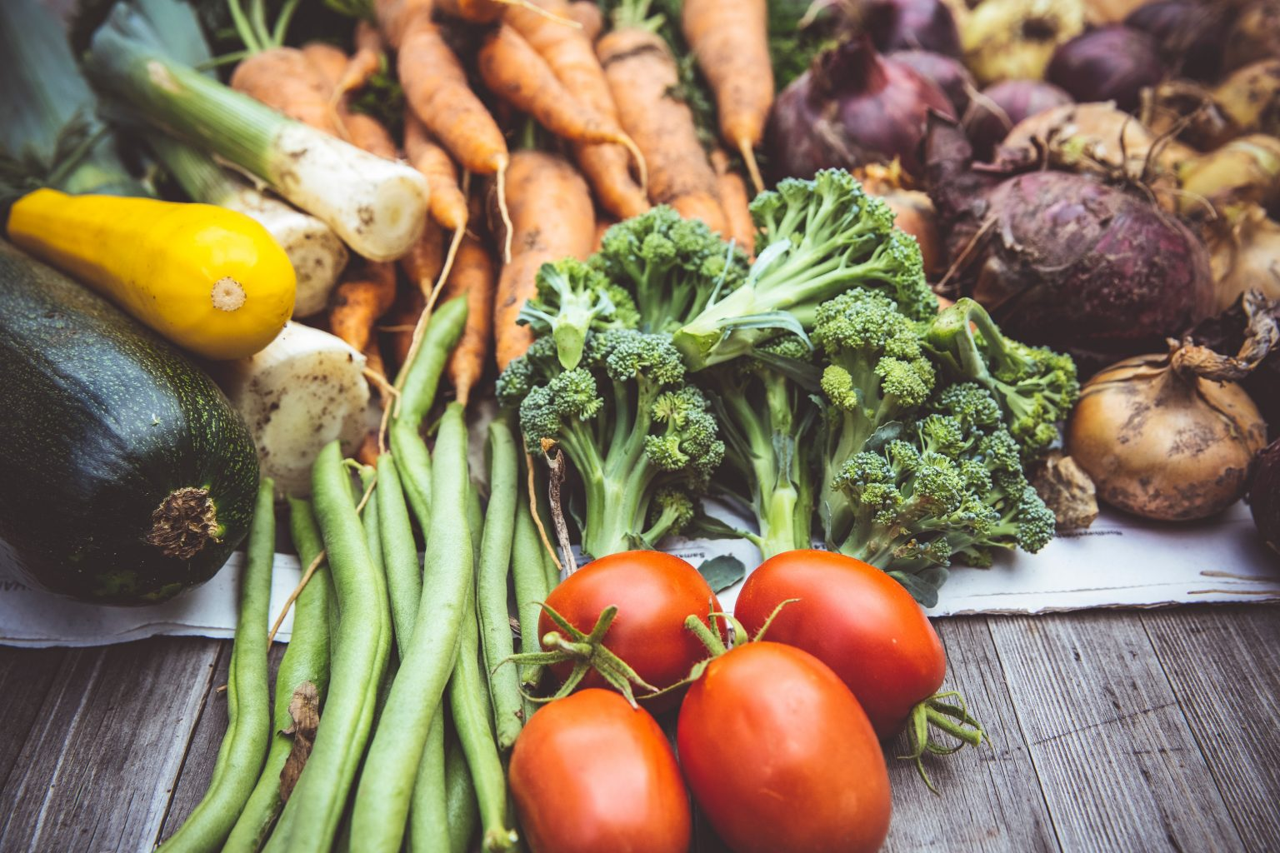
Selling Local Food Online
Levels the Playing Field
Automates Sales
Simplifies Operations
Decentralises the Food System

Slide 3
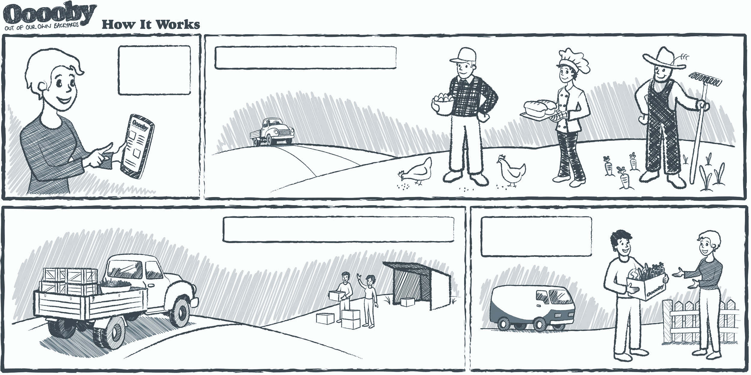
Problem
I can’t earn a decent living
I can’t get good food at a fair price
up to
80%
of the retail price
is supply chain

Slide 4
Solution
Farmers and suppliers join forces to sell direct
Deliver direct
80%
~40%
supply chain cost
Farmers double
gross margins
Better Food
Better Prices

Slide 5
Price Dynamics
Short Distance / Regenerative
Cost
Long Distance / Conventional
Time

Slide 6

Elephant in the Room
Food Security!

Slide 7
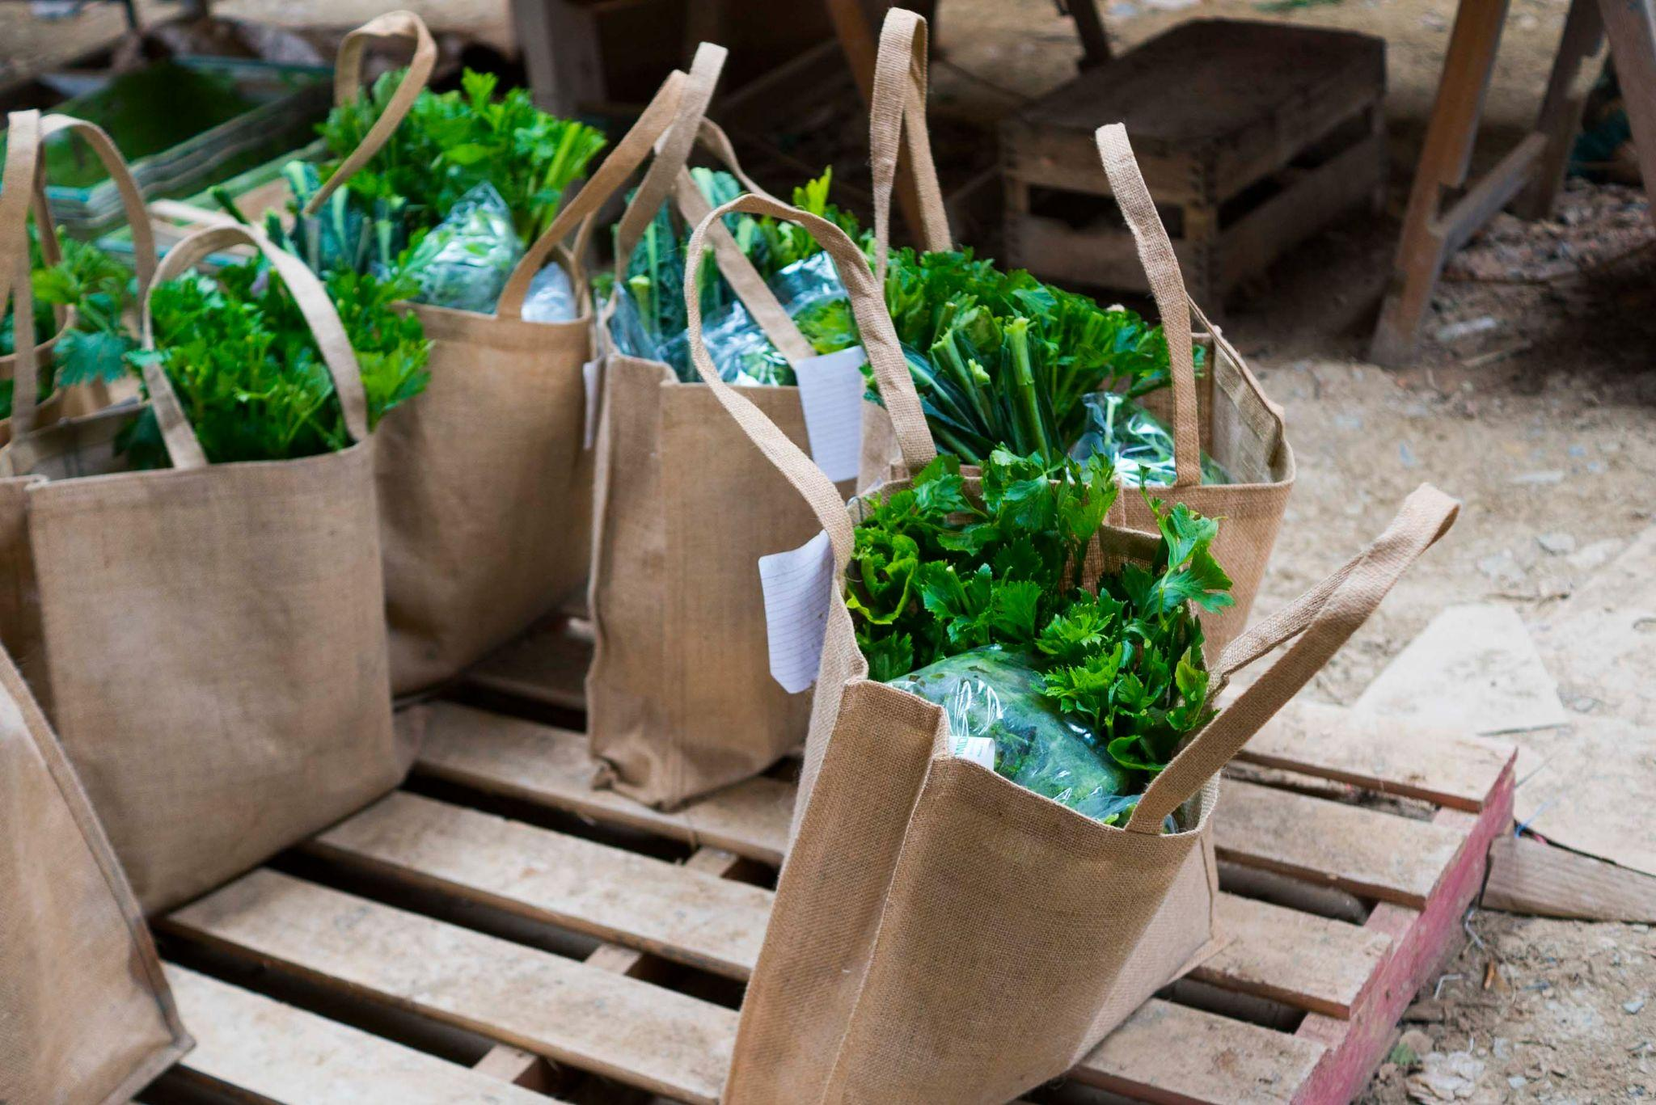
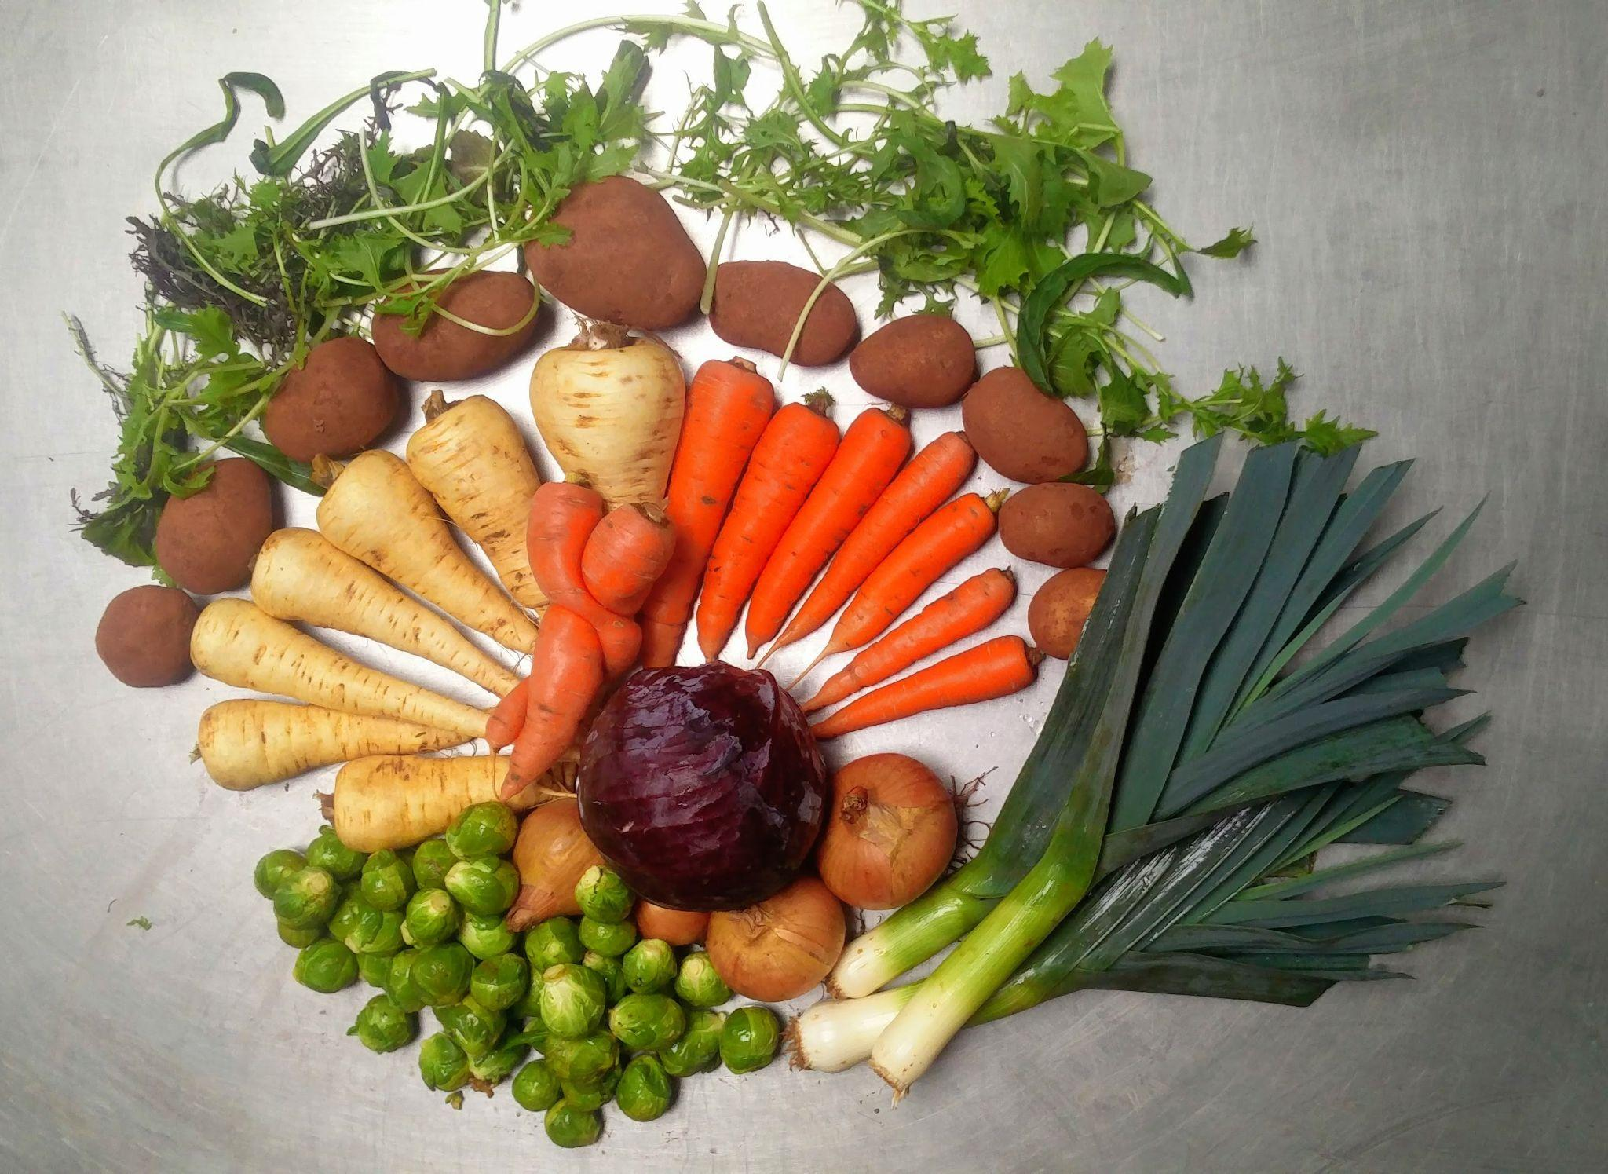
How The Apricot Centre Reaches Markets:
1. Local Delivery and Wholesale - Ooooby

Slide 8
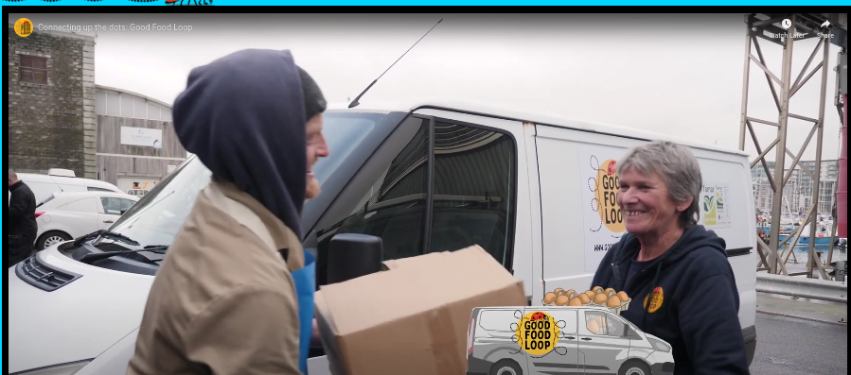
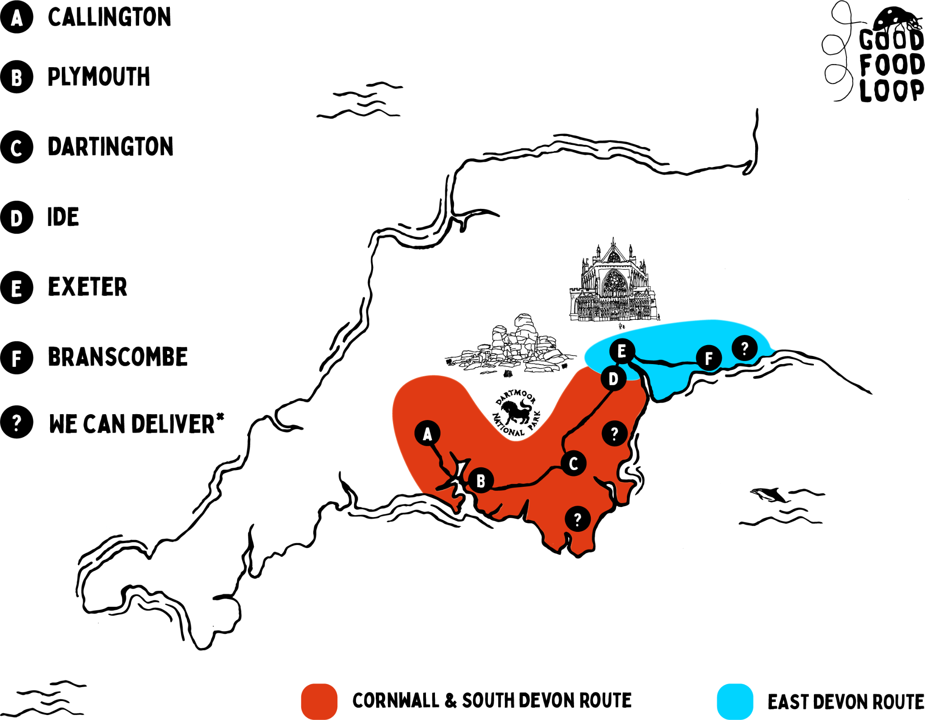
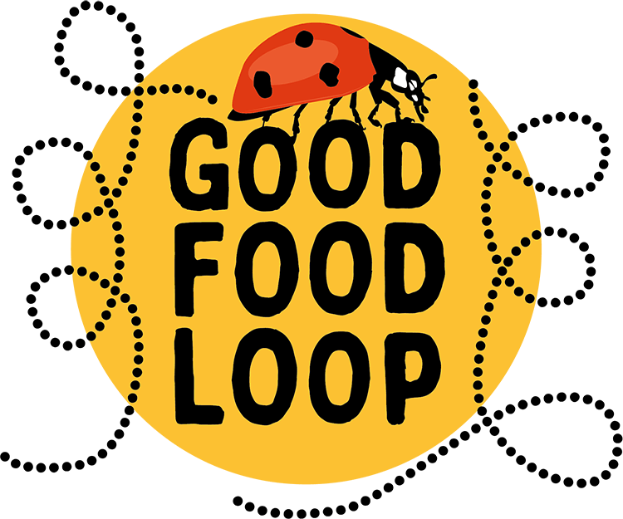
How The Apricot Centre Reaches Markets / Purchases Produce:
2. The Good
Food Loop

Slide 9
Connective Infrastructure
Platform diversity strengthens the sector by creating the right tools for the right businesses
Scaling requires deeper collaboration, which is more difficult with platform diversity
Food Data Collaboration is building data infrastructure to underpin diversity at scale

Slide 10

The Pilot
Exploration 1: Regional
Connecting producers & products across the Good Food Loop to enable simpler administration of the distribution network.
Exploration 2: Depth First
Automating ordering between Open Food Network food hub distributions & Hodmedods wholesale shopfront
Exploration 3: Breadth First
Using the extensive Big Barn directory to aim to connect more producers to food hub distribution networks.
Technical Partners
Open Food Network UK
Ooooby
Big Barn
Hodmedods
Data Food Consortium (France)
Governance Partners
Better Food Traders
The Landworkers’ Alliance
Sustain
Apricot Centre
Shillingford Organics
Open Food Network UK
Ooooby
Big Barn
Pilot funding from
National Lottery
Community Fund
Notes:
Sophie

Slide 11
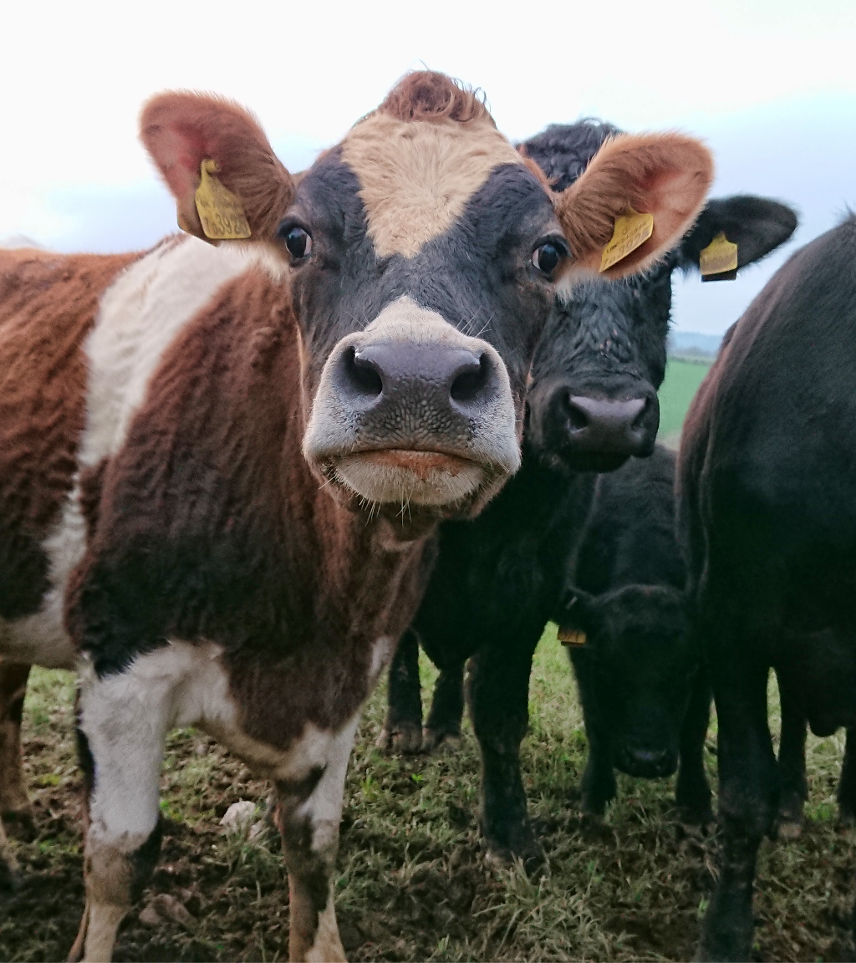
This has the potential to open up huge opportunities for small scale agroecological producers, helping widen their marketing and reach with very little additional cost and effort.
But more than that it’s a strategic necessity. If we are ambitious for local and short supply food systems – if want to feed tens of millions of people through them – then a high degree of cooperation is absolutely essential.
This project plays a very important role in enabling that to happen.
Tony Little, The Landworkers’ Alliance
Notes:
Sophie

Slide 12
Food
Data
Collaboration
Building data interoperability for
sustainable food systems
fooddatacollaboration.org.uk
twitter.com/UKFDC

