Slide 1


liege food belt ceinture aliment-terre liegeoisE)
Keep It Local Symposium - 10th November 2023

Slide 2
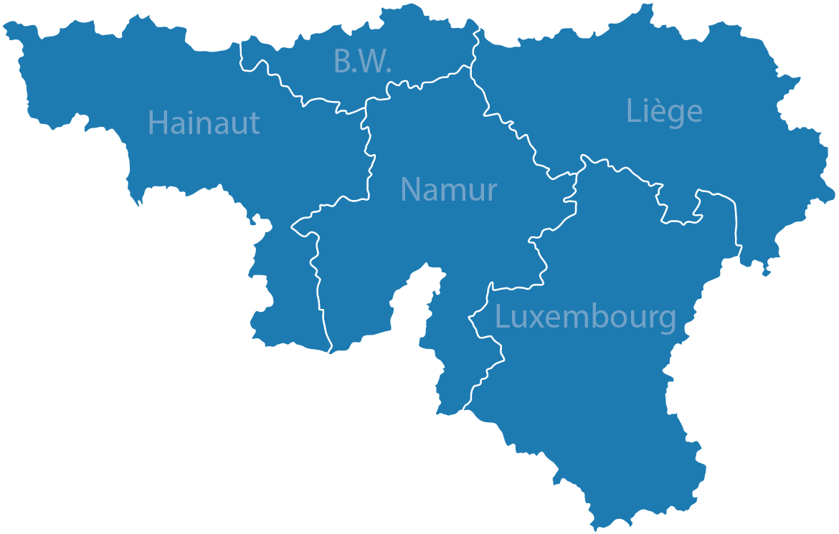

The liege food belt and its cousins
Mission : to co-construct a local, ecological and social food system
CWAD
Regional food council

Slide 3
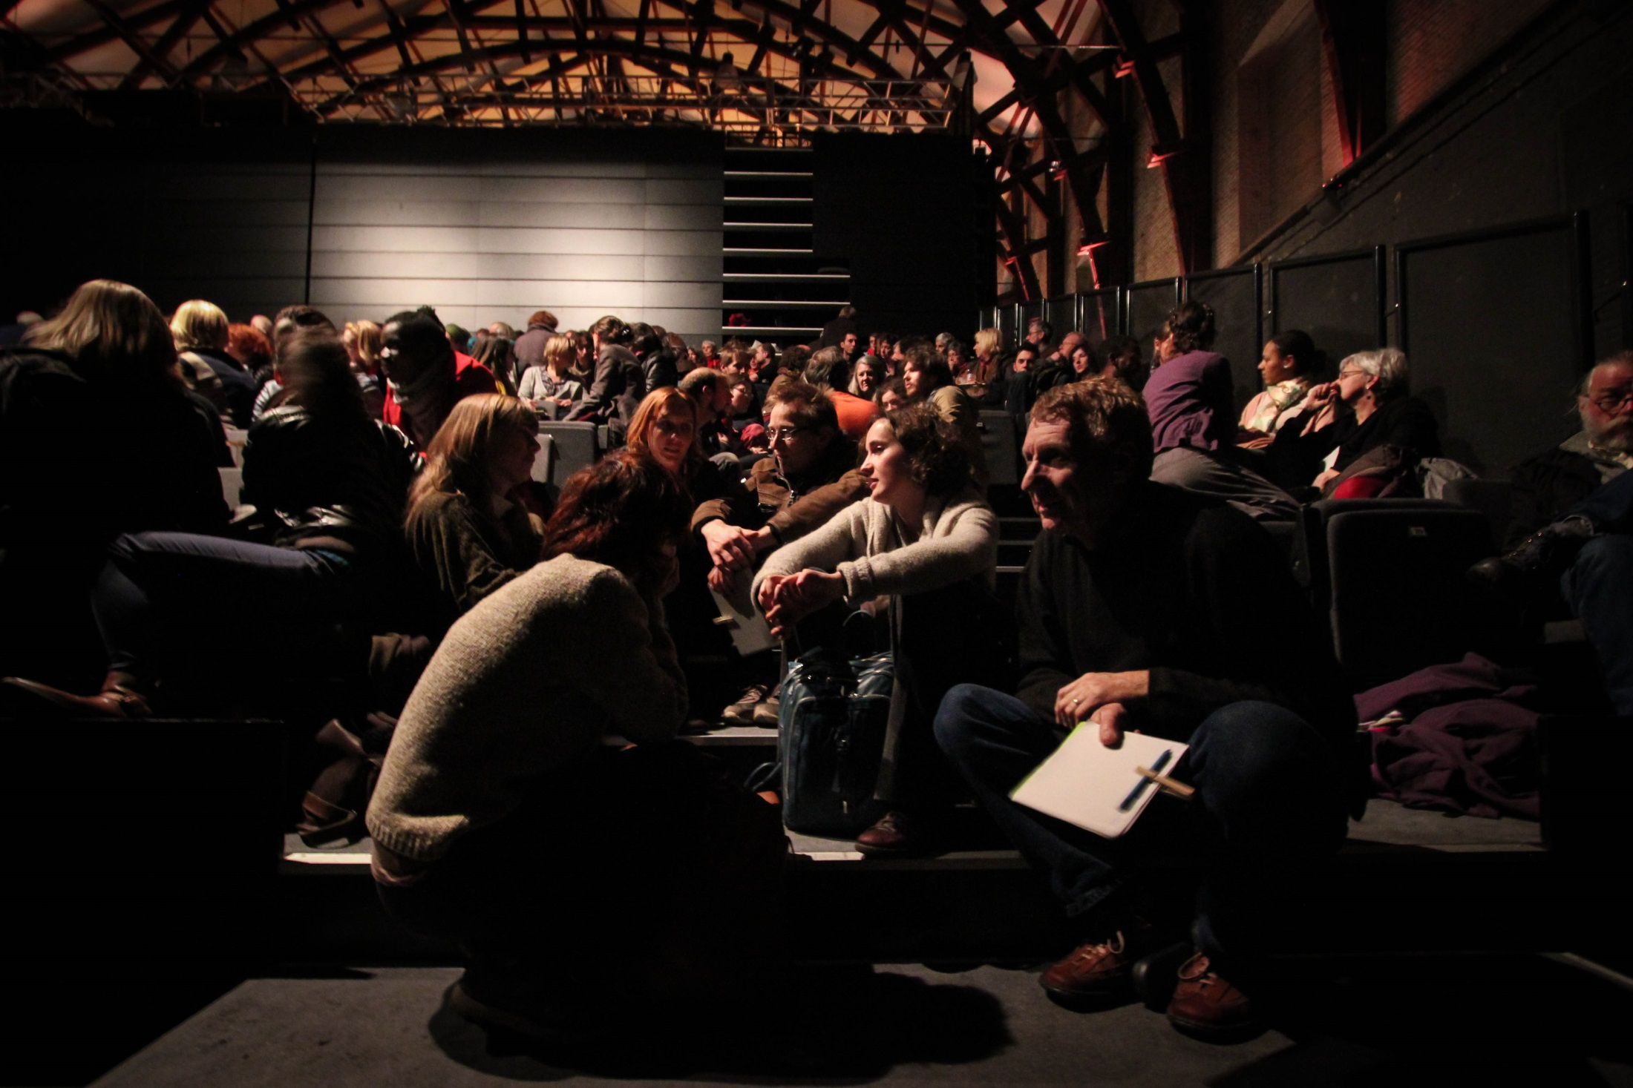
Origin (2013) – an event that mobilized the creativity of the community (600 persons)
“Imagine that within a generation, at least 50% of the food consumed locally is produced locally under the best ecological and social conditions…”

Slide 4
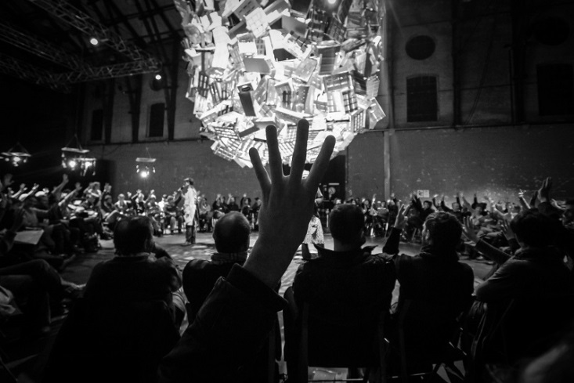

Origin (2013) collective intelligence tools
Open space technology

Slide 5
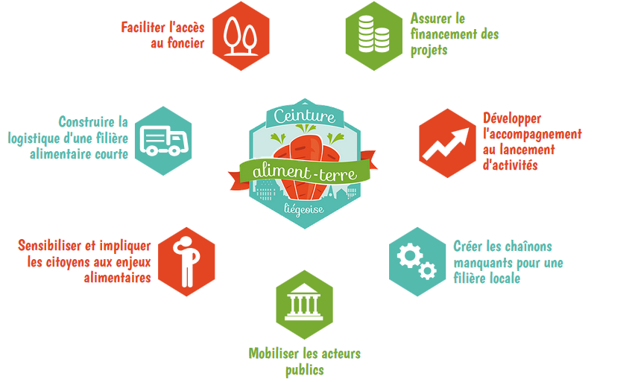
Aiming to Build a shared and systemic strategy
Access to land
Access to finance
Logistics organization
Training and business development support
Citizen awareness and involvement
Creation of missing links in local food chains
Partnership development with municipalities

Slide 6
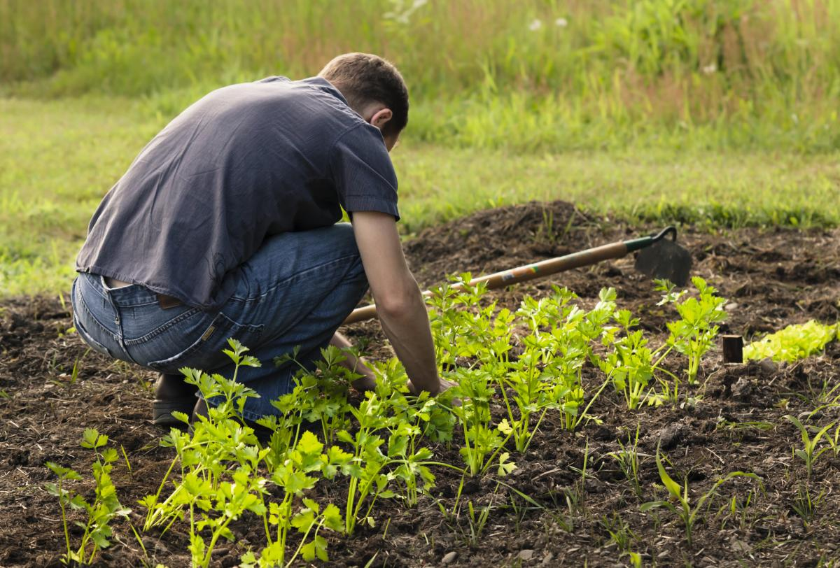
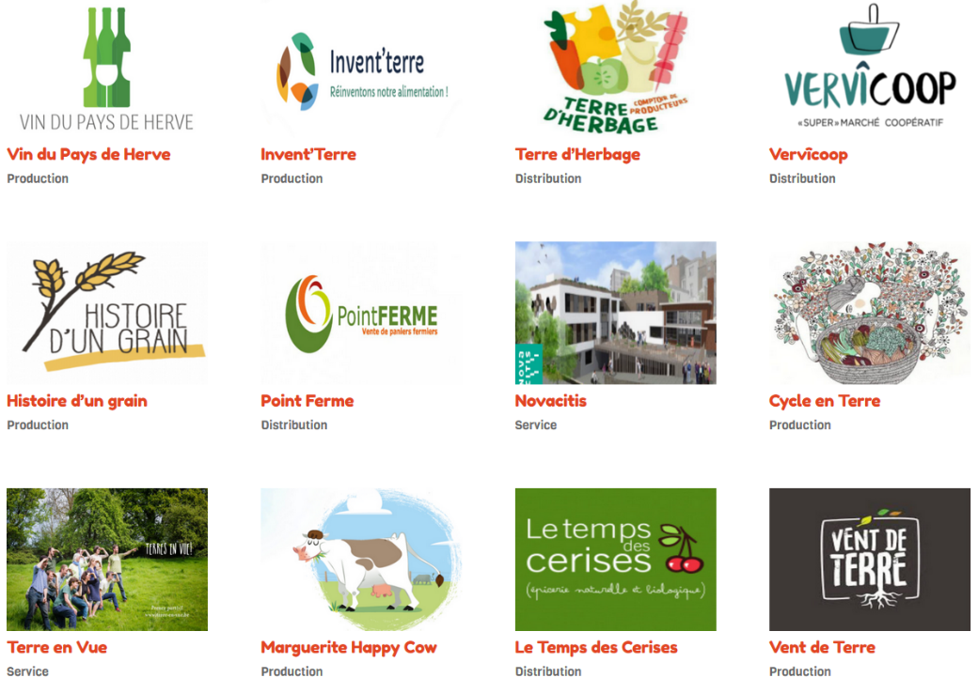
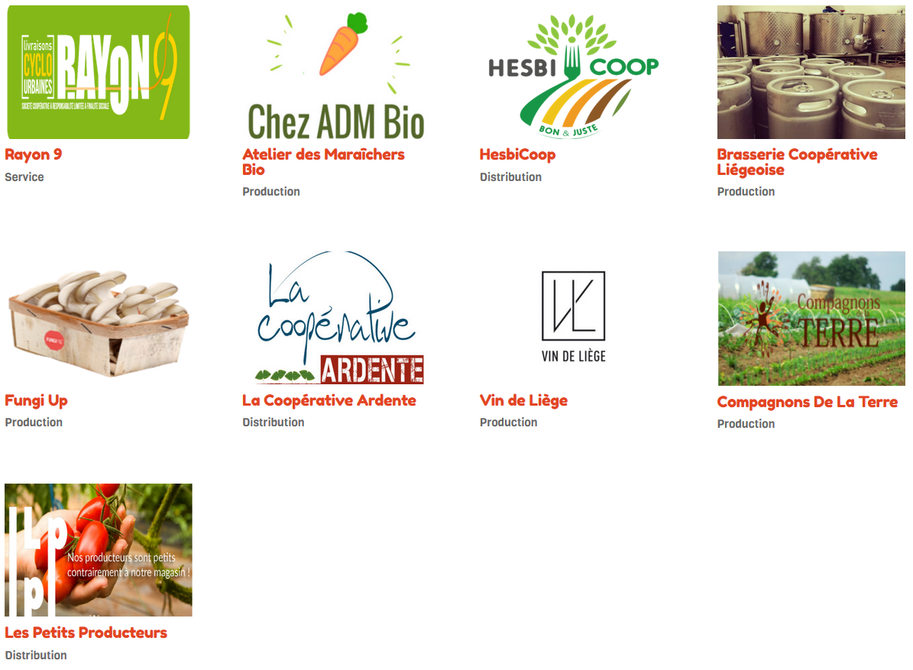


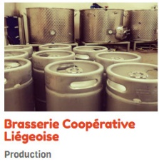
Supporting the boom of local sustainable food initiatives
~100 new vegetable producers
And ~20 new cooperatives

Slide 7
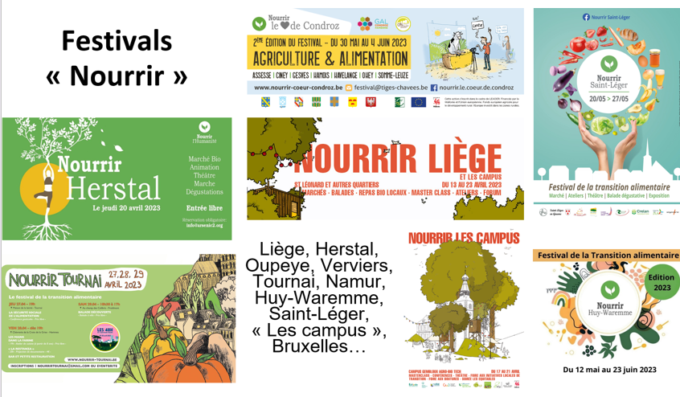
Raising awareness

Slide 8




Liege Métropole Food Policy Council
A partnership between the associative sector (Liege Food Belt), academics (Liege University) and 24 municipalities
Population of theses municipalities : 625.000 people

Slide 9
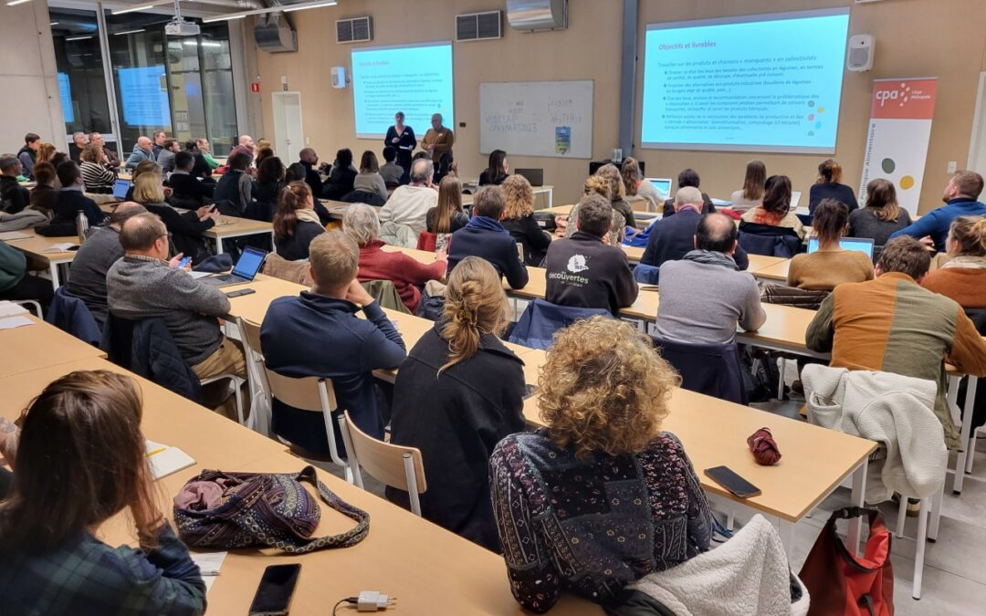
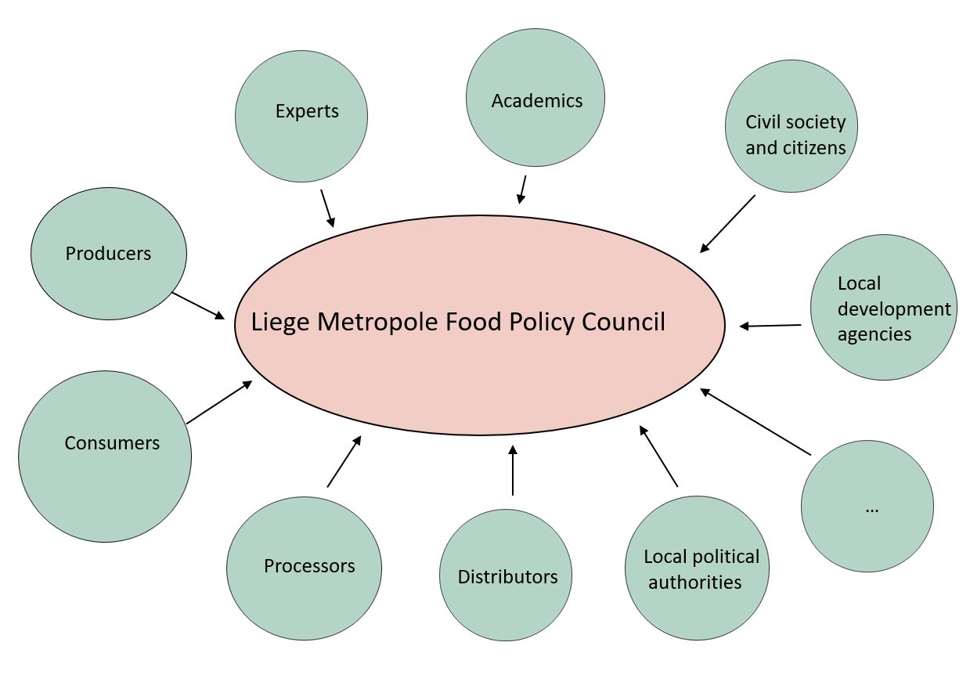
Liege Métropole Food Policy Council
120 members, representative of the food system stakeholders

Slide 10

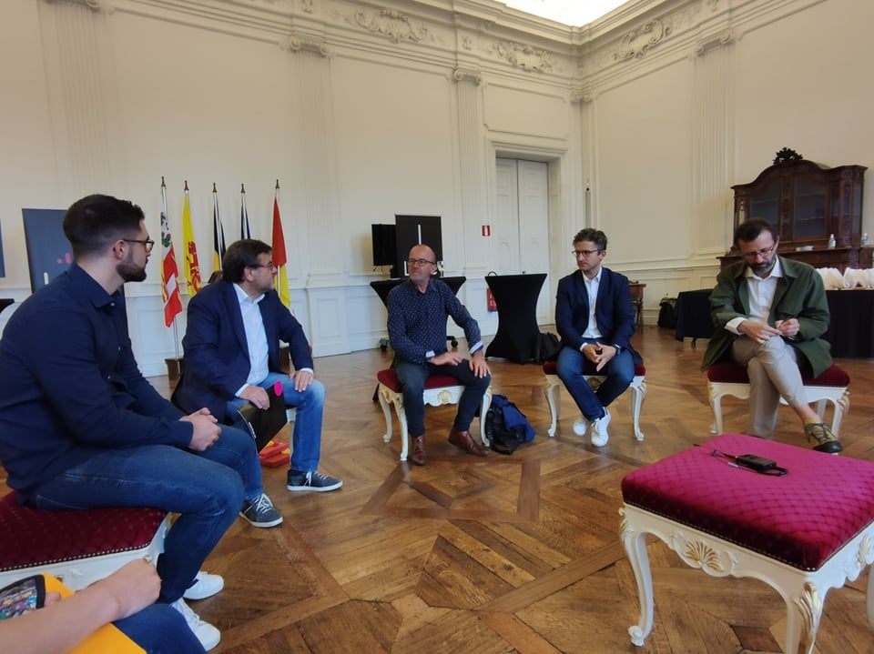

Involvement of local and regional authorities
Commitment of the city of Liège : by the end of 2024, 100% of schools and nurseries meals will be organic, seasonal and as local as possible

Slide 11
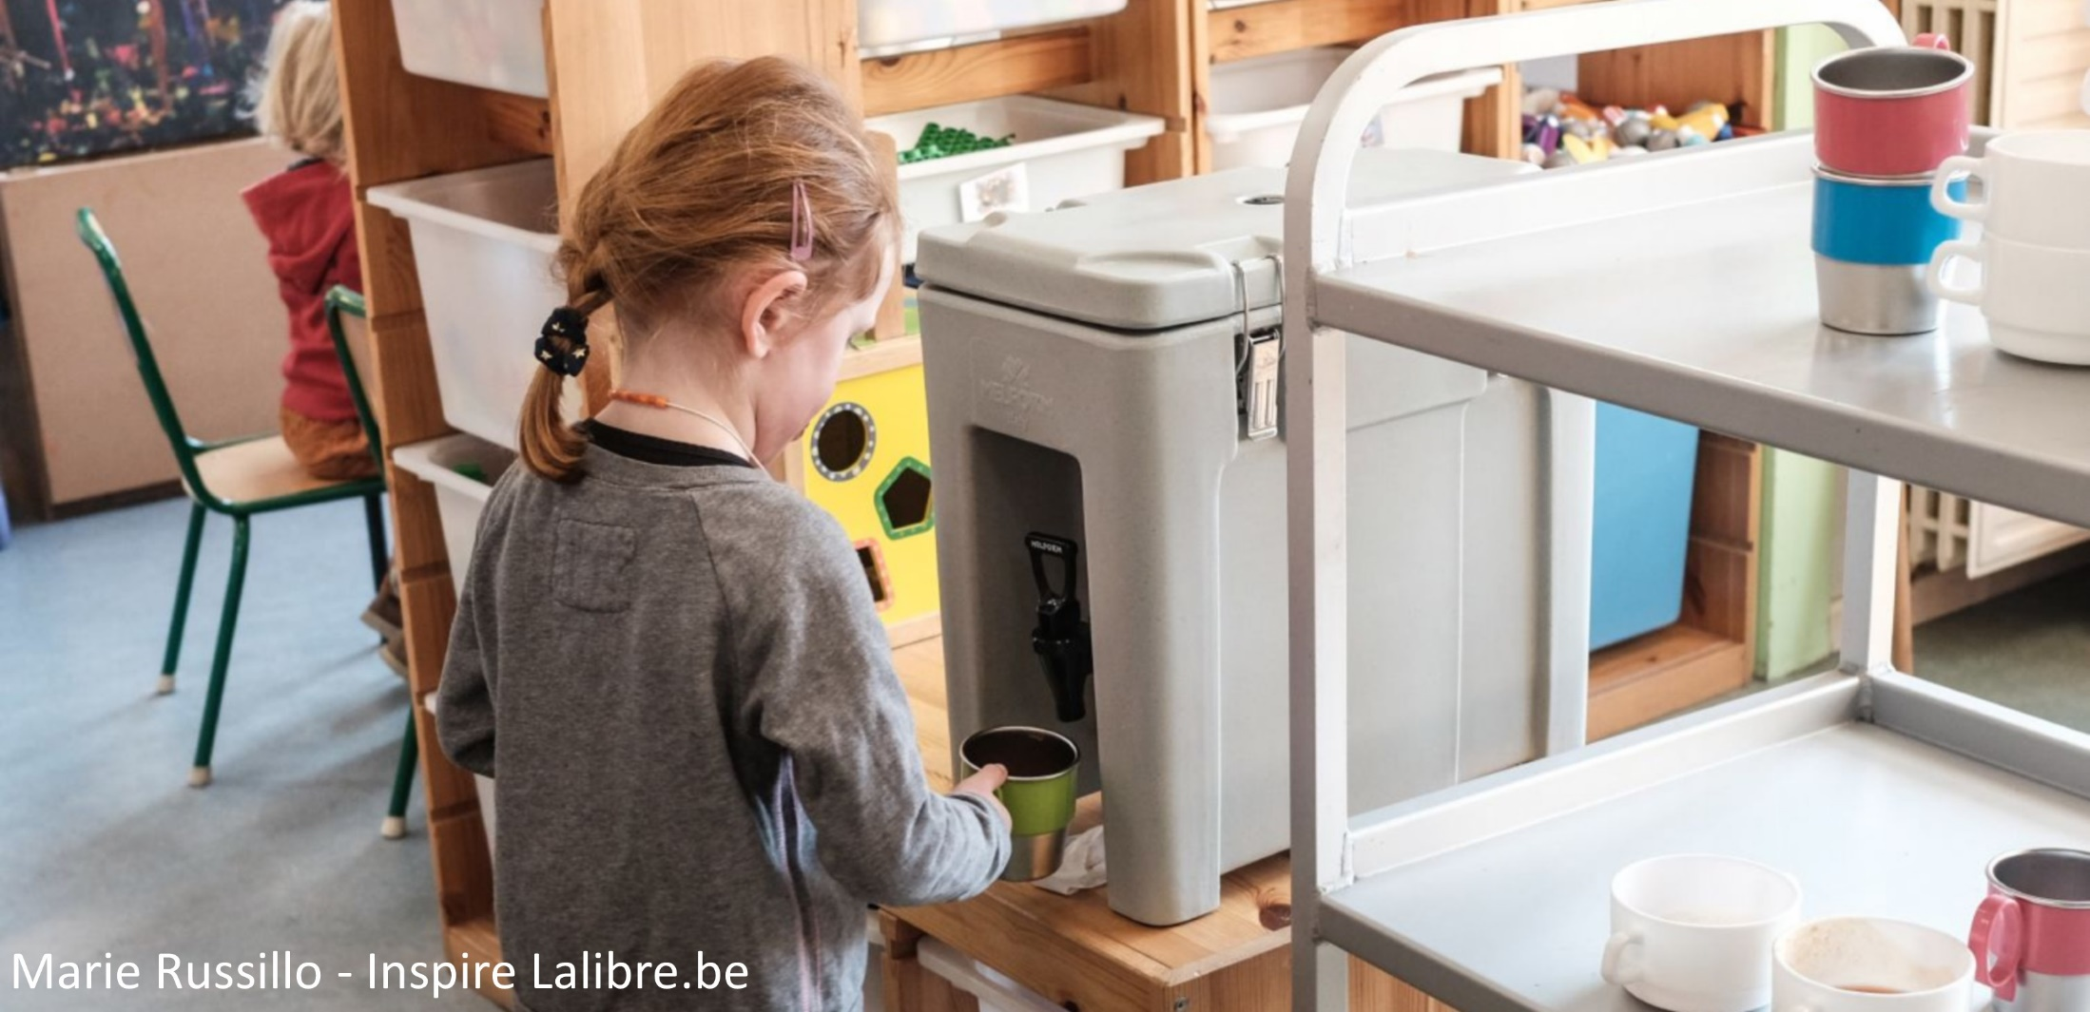
Involvement of local and regional authorities
« Local healthy soup snack » project, prepared with local or organic vegetables
More than 4000 children benefit from this program in the Liege area

Slide 12
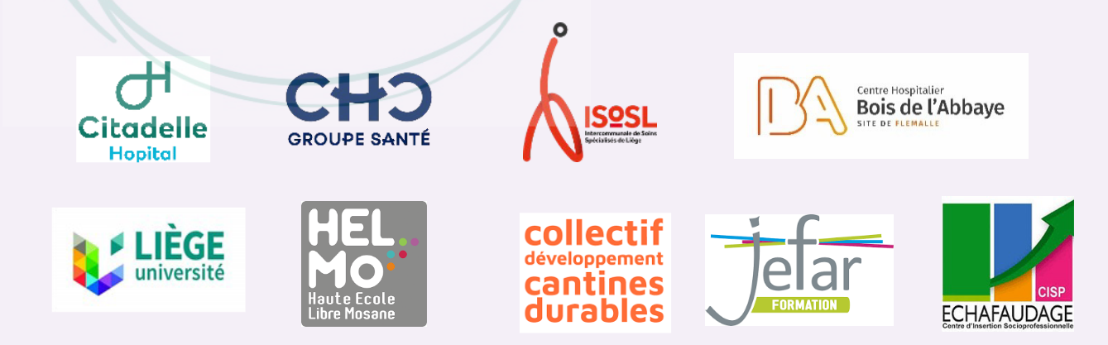
Liege Métropole Food Policy Council
The region's largest community kitchens are members of the food council and wish to source more locally and sustainably.

Slide 13
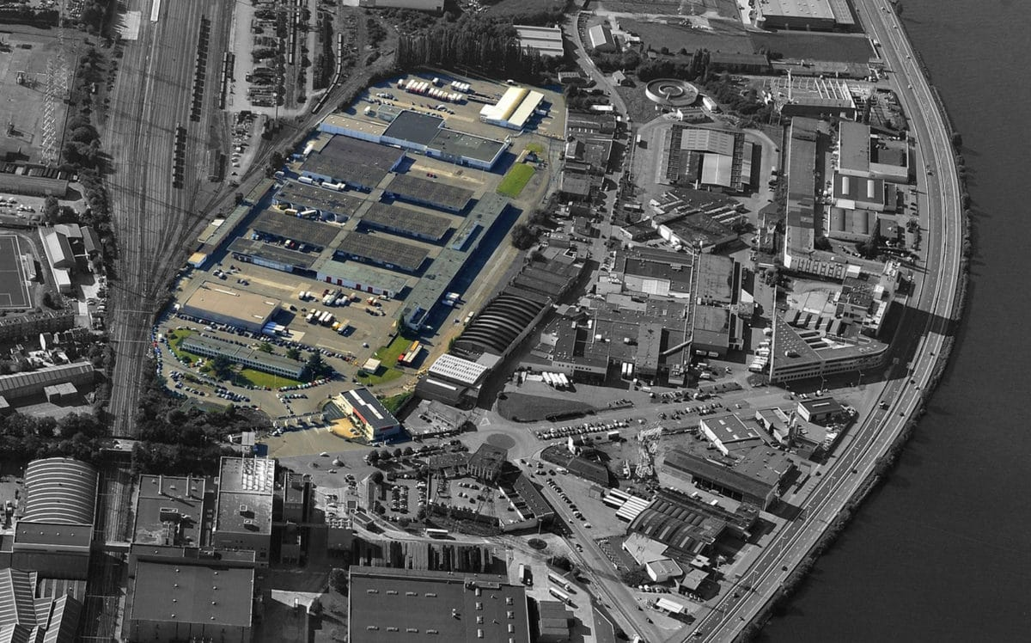
Creation of the missing links of the local food chains
  New activities
    Short circuits logistics hub
    Vegetable cannery
    Conservation unit
  Main customers
    community kitchens
    schools and nurseries
    hospitals
    rest homes
  Where ?
    Historic place of wholesale food trade,
    3 km from the city center
  How ?
    Partnership with the City of Liege

Slide 14
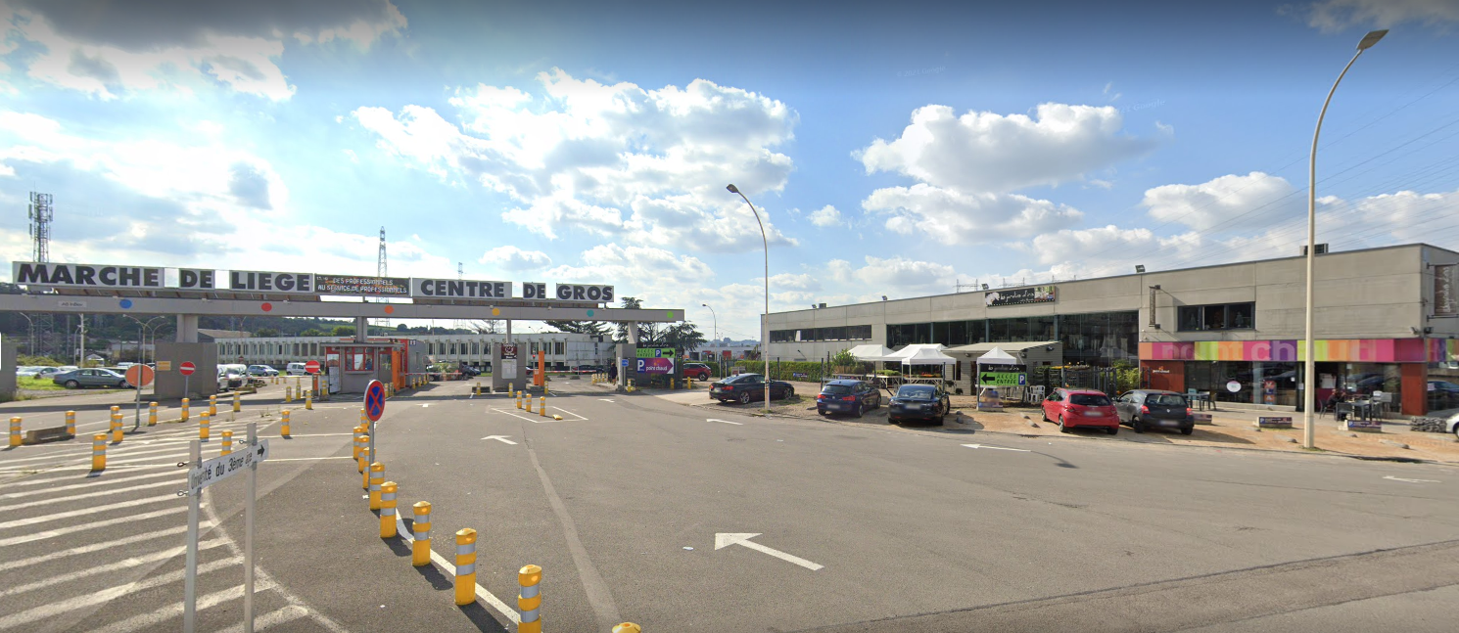

logistics hub for cooperatives of the liege food belt network
1700 m² building bought in 2022 by the city of liege
mutualization of logistics, it, administration…
Development of new b2b services

Slide 15
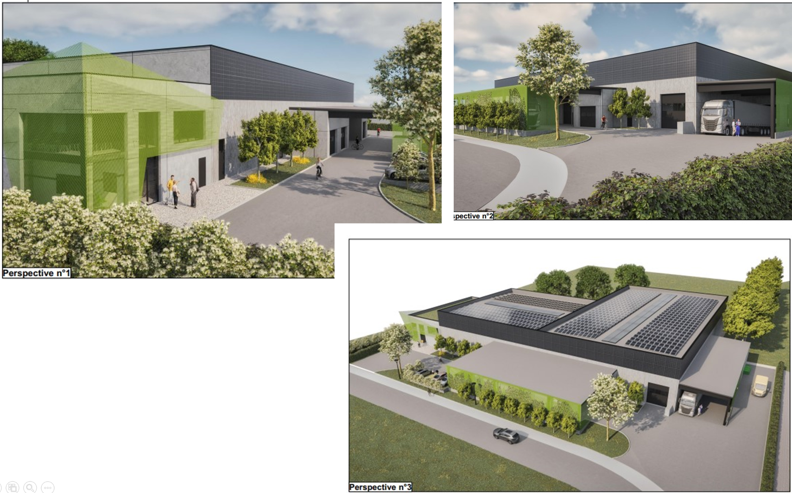
Creation the missing links in
Cooperation with local authorities
3000 m² building financed by the European recovery plan (mid-2025)
Activities :
Vegetable cannery + conservation unit

